Slide 1
DATA BREACH INVESTIGATIONS
By: Koo Wai Kit (TP081761)

Slide 2
AGENDA
01
02
03
Background
IoCs and OSINT
Types and Sources of Potential Digital Evidence

Slide 3
1. BACKGROUND
Process [1]
Data Breach → Occurs when unauthorized parties access sensitive information
Causes [1]
Human error
Insider threats
Malicious hacking for financial gain
Researching targets to identify vulnerabilities
Executing attacks (e.g., phishing, exploiting system flaws)
Compromising data for theft or ransom

Slide 4

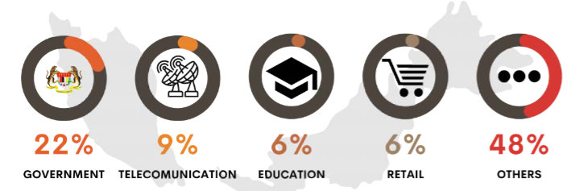
1. BACKGROUND
(2004 – present)
Global rank by breached accounts: 31st [2]
Total breached accounts: 52,030,140 (0.3% of global breaches) [2]
Top 5 sector affected (first half of 2023) [3]

Slide 5
2. IoCs
Indicators of Compromise (IoCs)
→ Critical pieces of threat intelligence for identifying potential security breaches
Common Types of IoCs
Network-based
Host-based
File-based
Behavioral
Metadata
Observation
Detection Methods [5]
Analysis
Known threat signatures

Slide 6
2. IoCs
Network-based IoCs [6]
Unusual outbound network traffic
Indicates possible data exfiltration or communication with C2 servers.
Connections to malicious IP addresses
Suggest attempts to manage compromised systems.
Unauthorized network scanning
Signals reconnaissance efforts by attackers.
Abnormal web traffic levels
Unusual spikes in traffic may indicate a security compromise.

Slide 7
2. IoCs
Host-based IoCs [6]
Unauthorized file changes
Modifications to system files or unauthorised software installations.
Unexpected system behavior
Issues like random restarts, system crashes, or slow performance
File-based IoCs [6]
Suspicious files or running processes
Presence of unfamiliar files or processes.

Slide 8
IoCs
Behavioural IoCs [6]
Privileged account irregularities
Unexplained actions from privileged accounts.
Irregular account behaviors
Uncommon login times or unauthorized access attempts.
Metadata IoCs [6]
Phishing emails
Emails requesting sensitive information or containing suspicious links / attachments

Slide 9
2. OSINT Tools
OSINT Tools
Shodan
Search engine for Internet-connected devices
VirusTotal
Analyzes files and URLs against multiple antivirus engines
Censys
Provides detailed information about configurations of internet-connected devices
PhishTank
Collects and verifies data on phishing websites
Maltego
Powerful data mining tool for gathering and analyzing information
Assesses organizational exposure to attacks
Identifies potential security weaknesses in exposed systems
Enables quick identification of potentially malicious content
Assists in evaluating security posture
Offers real-time information to recognize and avoid phishing attempts
Creates visual link analyses to reveal relationships and security threats

Slide 10
3. Types and Sources of Potential Digital Evidence (PDE)
Internal
Log Files
System, application, and security logs documenting network events.
Network Traffic Data
Captured packets indicating data exfiltration attempts.
Forensic Images
Snapshots of system states for detailed analysis.
System Artifacts
Registry entries and configuration files highlighting anomalies.
Email Data
Evidence of phishing attacks or malicious communications.
Cloud Data
User activity tracking from service providers.
Endpoint Data
Details about installed software and user activity from devices.

Slide 11
3. Types and Sources of Potential Digital Evidence (PDE)
External
Threat Intelligence Feeds
Aggregate data about known threats and vulnerabilities.
Third-Party Logs
Logs from external service providers that provide context about breaches.
Public Databases
Reveal compromised data and related information.
External Forensic Services
Engage experts for enhanced investigation and analysis.

Slide 12
CONCLUSION
Indicators of Compromise (IoCs):
Network-based, host-based, file-based, behavioural, metadata
OSINT Tools:
Shodan, VirusTotal, Censys, PhishTank, Maltego
Potential Digital Evidence (PDE):
Includes log files, network traffic data, forensic images, system artifacts, email data, cloud data, and endpoint data.
Evaluation of Sources:
Internal sources
logs, traffic data, forensic images, system artifacts, email data, cloud data, endpoint data.
External sources
threat intelligence feeds, third-party logs, public databases, forensic services.

Slide 13
REFERENCES
Kosinski, M. (2024, May 24). What is a data breach?. IBM. Retrieved from https://www.ibm.com/topics/data-breach
Surfshark. (2024, July 15). Global data breach statistics. Retrieved from https://surfshark.com/research/data-breach-monitoring
Cybersecurity Malaysia. (2023). Mid-year report, threat landscape 2023. Retrieved from https://www.cybersecurity.my/data/content_files/26/2511.pdf#page=14.14
MyCert. (2024, September 18). MyCERT report - cyber incident quarterly summary report - Q2 2024. Retrieved from https://www.mycert.org.my/portal/advisory?id=SR-027.092024
Cloudflare. (n.d.). What are indicators of compromise (IoC)?. Retrieved from https://www.cloudflare.com/learning/security/what-are-indicators-of-compromise/
SentinelOne. (2023, March 11). What are Indicators of Compromise (IoCs)?. Retrieved from https://www.sentinelone.com/cybersecurity-101/threat-intelligence/what-are-indicators-of-compromise-iocs-a-comprehensive-guide/

Slide 14
THANKS
Any questions?
Please keep this slide for attribution

